Slide 1

Intelligent Layered Smart Door Lock System using Raspberry Pi
Enhancing security through biometric authentication and real-time GSM alerts.
Project by:
Gopikrishna K - CB.EN.U4ELC22012
Harikrishnan MIraj - CB.EN.U4ELC22014
JAISRIHARI G - CB.EN.U4ELC22015
NANDAN RAJESH - CB.EN.U4ELC22063

Slide 2

Introduction: The Need for Smart Security
Modern Security Concerns
Biometric Authentication
Project Goal
Traditional locks and password-based systems have vulnerabilities.
Face recognition is a secure, convenient alternative.
Develop a smart door lock using face recognition and real-time GSM alerts.

Slide 3
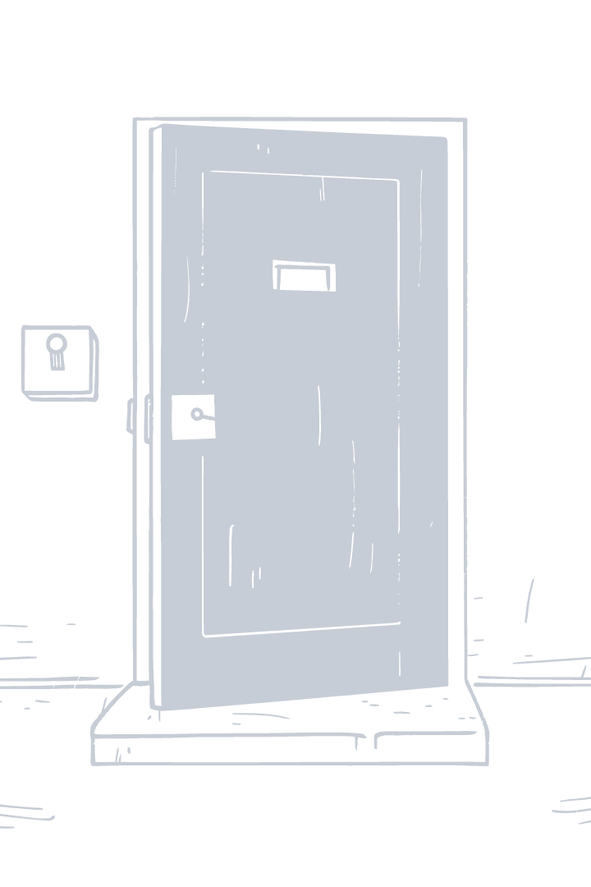
Abstract
This project introduces a smart door lock system that uses real-time face recognition for secure access. A Raspberry Pi with a Pi Camera captures and processes facial images, unlocking the solenoid lock upon successful authentication. An ultrasonic sensor monitors door activity for added security and efficient usage of camera.
The system also includes a GSM module for remote access via SMS and IoT integration for monitoring and control.

Slide 4
Problem Statement
The smart door lock system aims to address the rising concerns of security breaches due to traditional locks and passwords by implementing advanced biometric authentication using face recognition.
By incorporating real-time GSM alerts, the system provides an additional layer of security and immediate notification in case of unauthorized access attempts. This project not only enhances security measures but also aims to reduce the financial losses caused by burglaries.

Slide 5
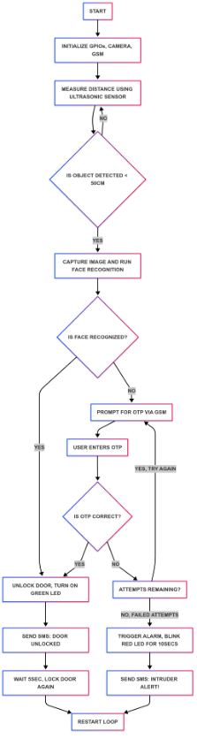
Methodology
Start – The system begins operation.
Initialize Components – It sets up the GPIOs, camera, and GSM module for use.
Measure Distance – The ultrasonic sensor checks if someone is near (less than 50 cm from the door).
Face Recognition
If a person is detected, the camera captures an image and runs face recognition.
If the face is recognized, the door unlocks, a green LED turns on, and an SMS notification is sent.
After 5 seconds, the door locks again.
OTP Verification (if face is not recognized)
If the system does not recognize the face, it sends an OTP via SMS.
The user enters the OTP. If correct, the door unlocks as above.
If incorrect, the user gets another chance.
If all attempts fail, the system triggers an alarm(buzzer) alerting the home owner and the
neighbors that there is an intruder trying to break in, blinks a red LED, and sends
an intruder alert SMS.
Restart Loop – The system resets and waits for the next person.

Slide 6
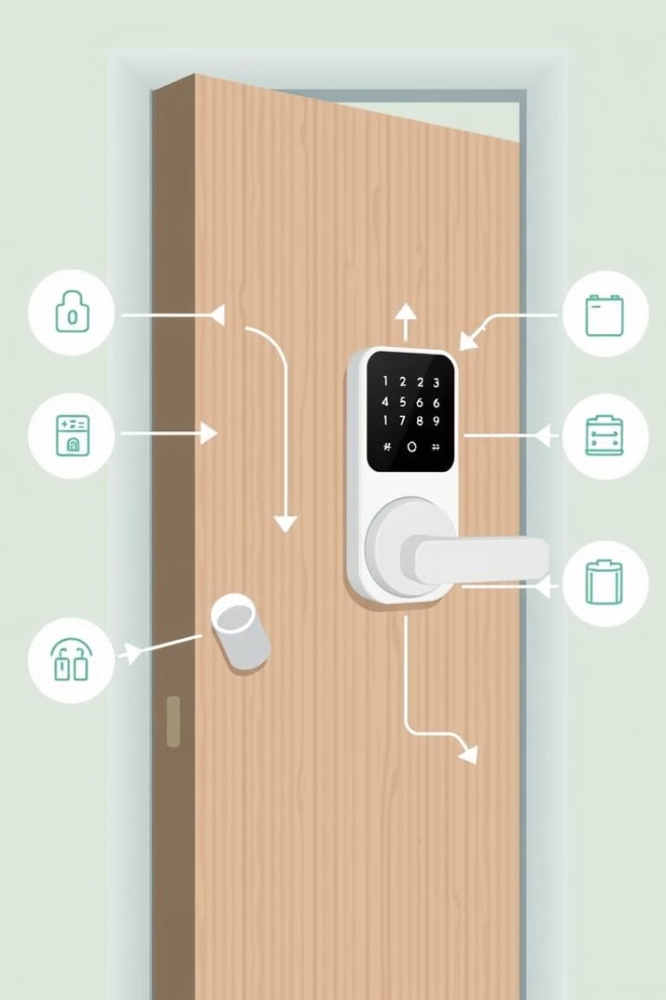
System Architecture: How It Works
1
Camera Module
Captures real-time images at the door.
2
Face Recognition Algorithm
Identifies authorized personnel.
3
Microcontroller
Controls the door lock and communication.
4
GSM Module
Sends SMS alerts for OTP and unauthorized access.

Slide 7
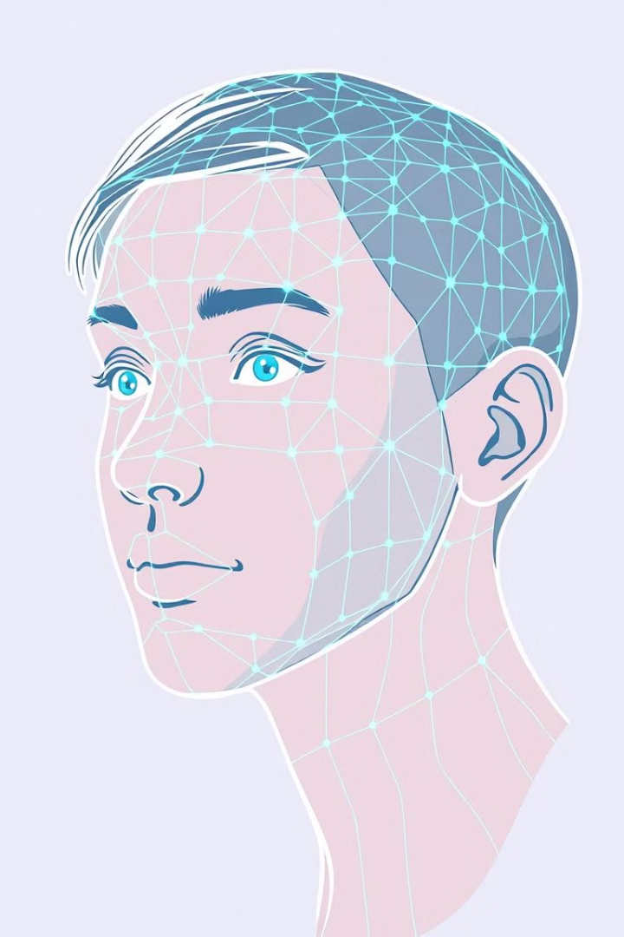
Face Recognition Algorithm Details
Algorithm Selection
Training Data
Pickle encoding was used for training the dataset
Collection of facial images of authorized users. Dataset of 25 images per user.
Recognition Process
Detecting and recognizing faces in images in real-time with pi-cam module (HOG).

Slide 8
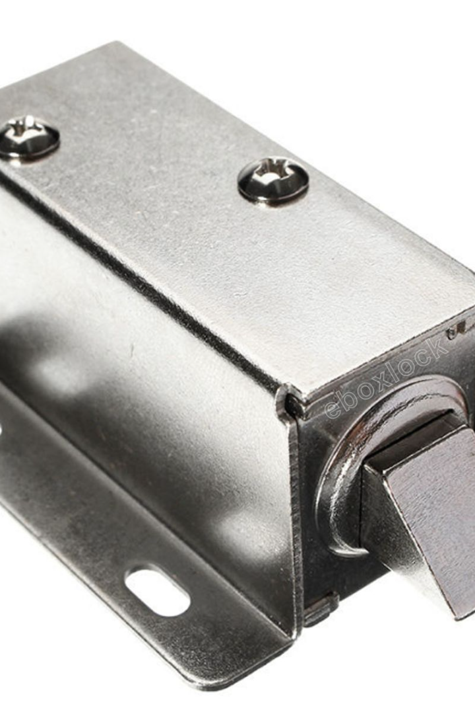
Solenoid Implementation
The solenoid receives a signal from the microcontroller to either unlock or lock the door.
It utilizes an electromagnet to control the deadbolt mechanism for secure door access.
The solenoid is a crucial component in the system's ability to physically control the entrance based on authentication.

Slide 9
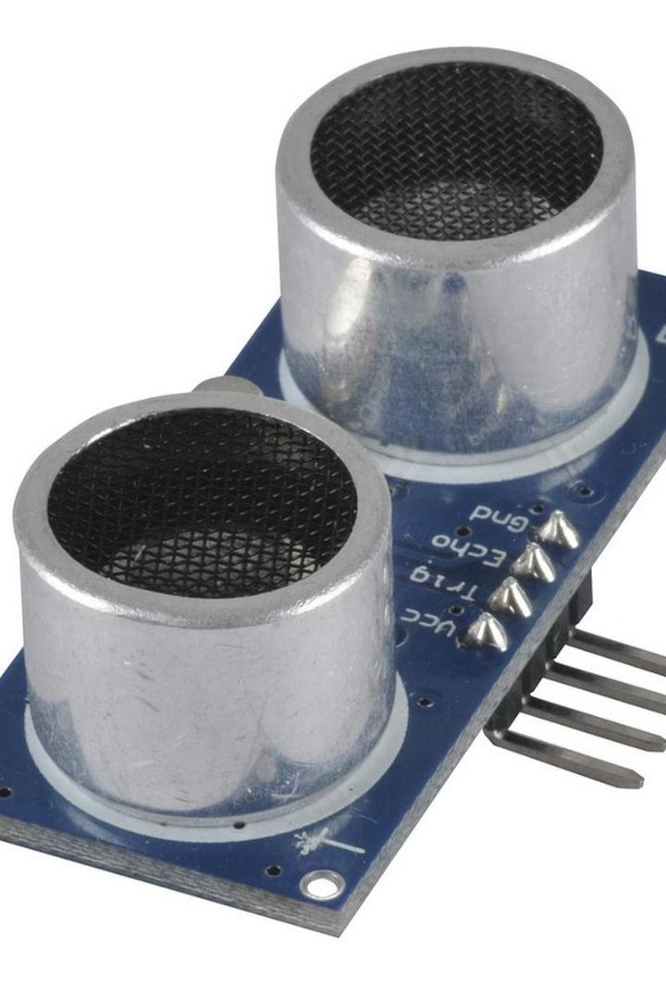
Ultrasonic Implementation
The ultrasonic sensor is responsible for detecting motion near the door.
It measures the distance between the sensor and any object in its path to determine if someone is approaching.
This information is used to trigger the face recognition algorithm and activate the system for the next person.

Slide 10
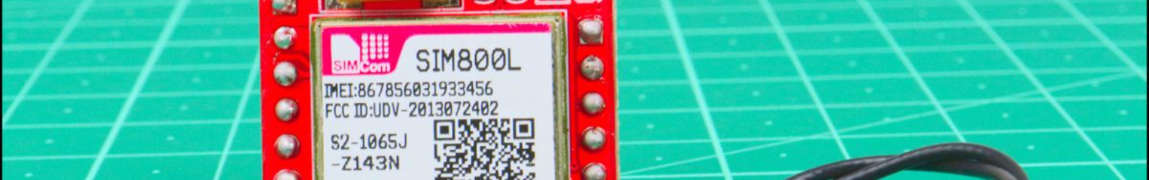
GSM Alert System Implementation
GSM Module Integration
1
Configuration and interfacing.
2
Alert Triggers
Unauthorized face or forced entry.
SMS Content
3
Includes timestamp of the incident.
4
Security Features
Protection against spoofing.

Slide 11
Hardware and Software Components
Hardware Components
Software Components
Raspberry Pi Camera Module Rev 1.3
Raspbian OS
Raspberry Pi 4 Model B
Python with CV2,RPi.GPIO,face_recognition,picamera2 libraries
SIM800L GSM Module
Serial SMS Library
12V DC Solenoid Lock with Single Channel Relay
Pickle Encoding
Keypad Matrix
Ultrasonic HC-SR04
Buzzer and Leds

Slide 12
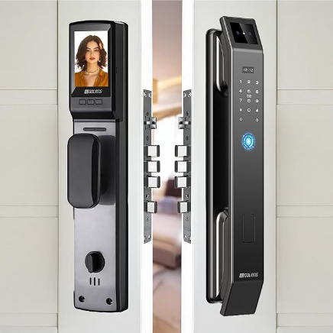
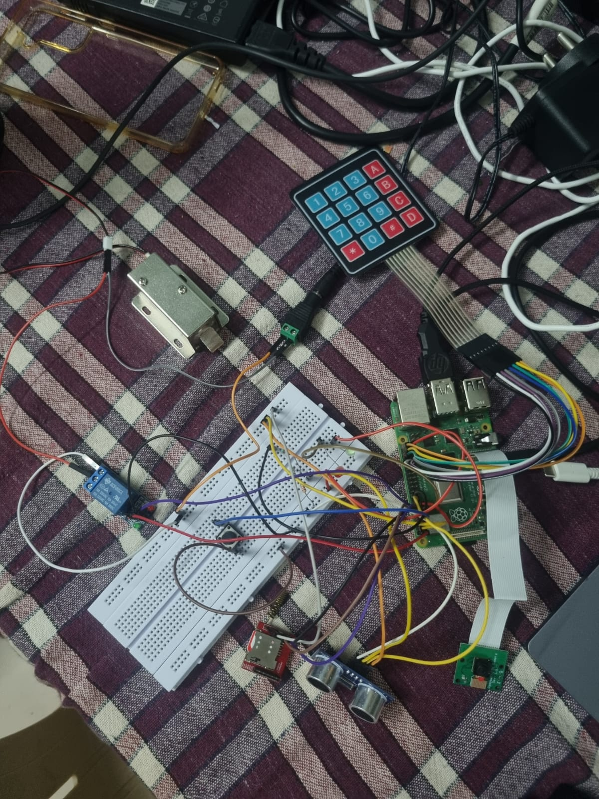
Comparison
Market available:
Our Project:
Cost - 12.9k
Cost - 8.6k
Features - Face recognition, scanner, RFID, OTP, Pin, Mobile App, Mechanical Key.
Features - Face Recognition, OTP.

Slide 13
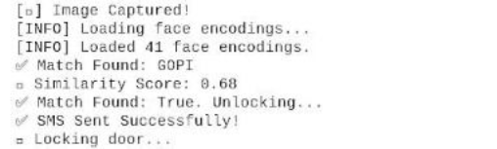
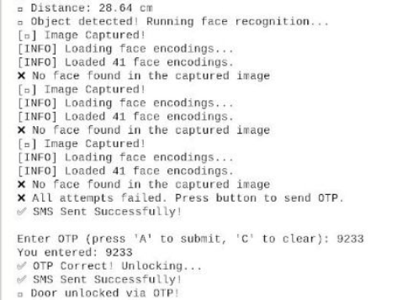
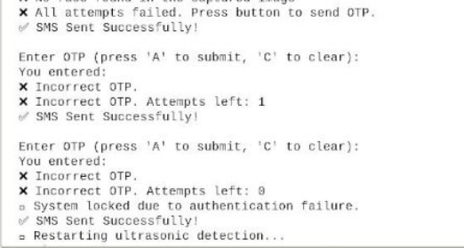
Results and Demonstration
Case 1 : Known Person Enters
Case 3 : OTP Wrong(Intruder)
Case 2 : Enter in With OTP

Slide 14
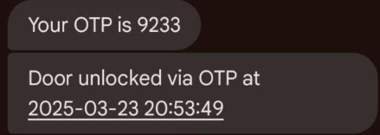
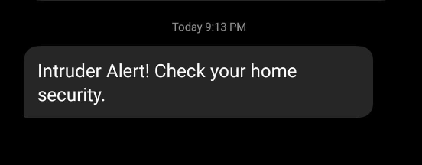
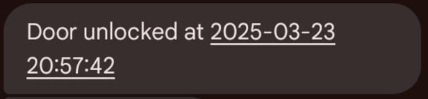
OTPs
Case 1
Case 3
Case 2

Slide 15
Challenges Faced:
Hardware Issues - Modules like GSM, Relay and Pi-camera were faulty in progress of the project so such components had to be replaced
In Initial stages of the project, necessary libraries need for face recognition couldn't be downloaded properly
Due to the size of the Raspberry Pi , usage of many modules and lots of connections, required Model for encasing the components weren't made.

Slide 16
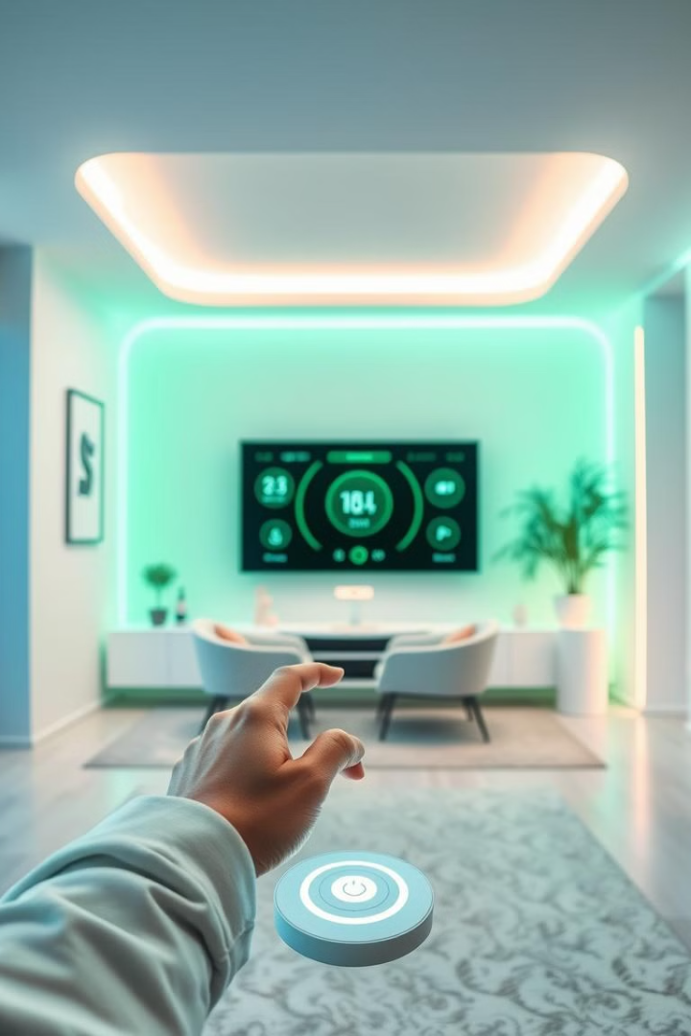



Future Enhancements
Cloud Integration
Mobile App Control
Battery Backup

Slide 17
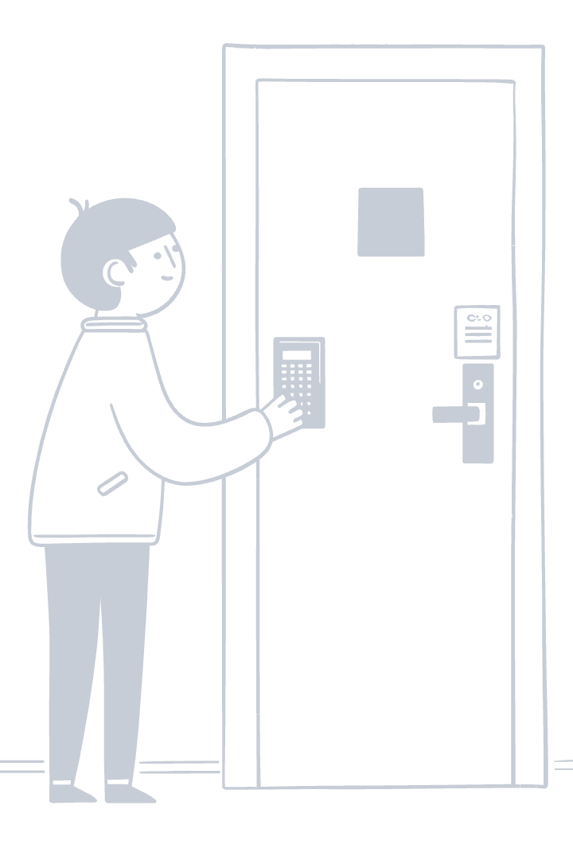
Conclusion
The smart door lock system successfully enhances security by integrating real-time face recognition and OTP-based authentication. By using a Raspberry Pi, Pi Camera, ultrasonic sensor, Keypad and GSM module, the system ensures secure and automated access control. The dual-layer authentication mechanism prevents unauthorized access, while the intruder alert system adds an extra layer of security.
This project offers a convenient, efficient, and scalable solution for homes and offices, reducing the risks of traditional key-based locks. Future improvements can include cloud integration/mobile app for remote monitoring battery backup in case of emergencies. Overall, this system provides a smart, reliable, and user-friendly security solution.

